Slide 1

MULTILINGUAL RAG
S
SUBMITTED BY:
PRINCE FRANCIS

Slide 2
CONTENTS
Getting Multilingual audio
Techs used in the project
Built a chat bot using streamlit
Question Generation
Evaluation
References

Slide 3
GETTING MULTILINGUAL AUDIO
Used Openai TTS to convert a small chunk of data from the YOLO-pdf.
YOLO pdf link→ 1506.02640.pdf (arxiv.org)
Used first 2 paragraphs and converted text into audio files of 5 different languages namely Spanish, Dutch, Italian, English, German.
Reason: Above mentioned are some of the languages with highest accuracy in openai –whisper.
Reference: ./audio_file
Converted these audio files using openai-whisper using API call.
Reference:./txt_files
NOTE: Only used the yolo_dutch.txt file with this project
NOTE: Create an OPENAI_API_KEY to run the app.

Slide 4
TECH USED IN THE PROJECT
Openai-whisper : To convert the multilingual audio into English for the RAG system to understand.
llama_index: To Build a RAG .
OpenAI : LLM
Streamlit : To develop a chatbot.
OpenaAI TTS: Other mentions

Slide 5
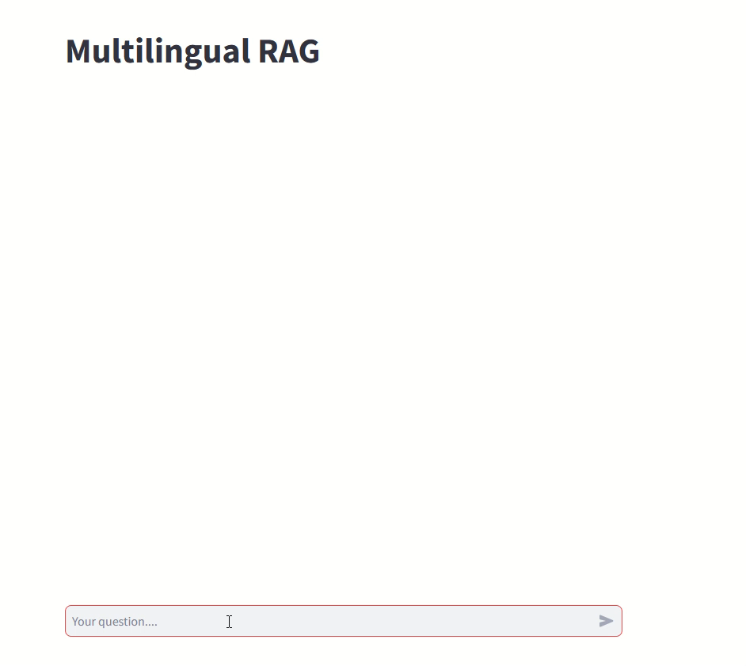
BUILT A CHAT BOT USING STREAMLIT

Slide 6
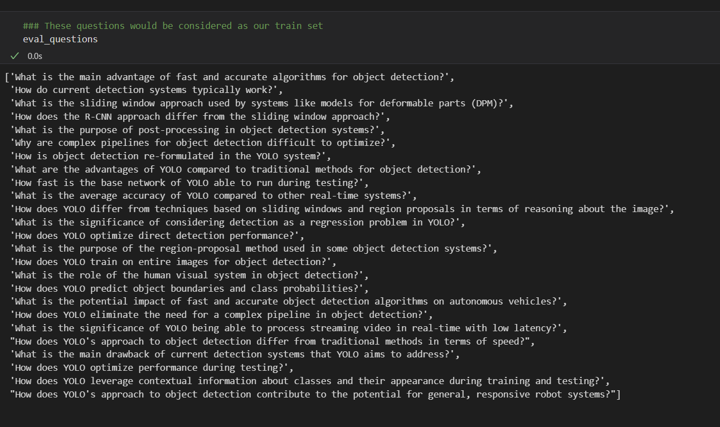
QUESTION GENERATION
Created questions out of the dataset for evaluation.

Slide 7
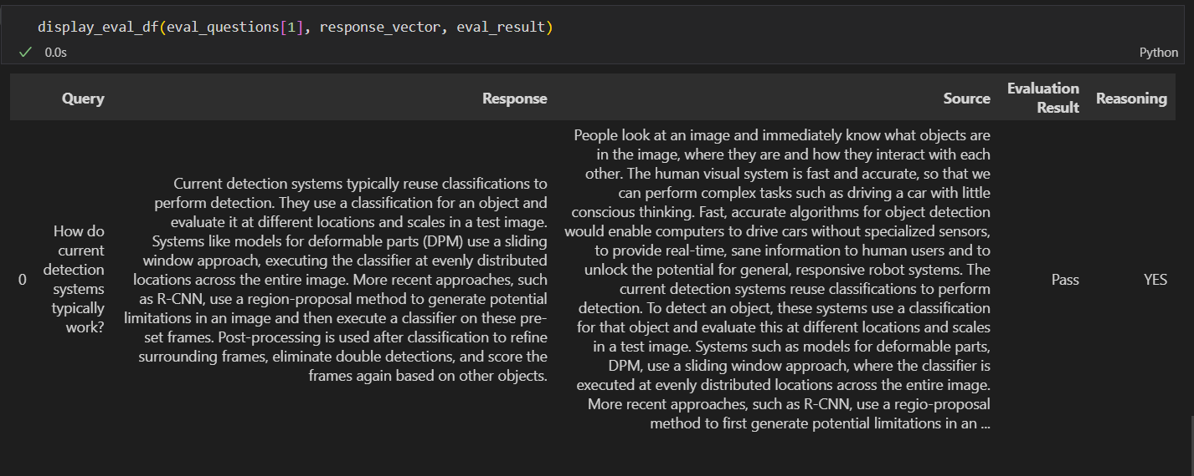
EVALUATION
RELEVANCY EVALUATOR: used to measure if the response + source nodes match the query.
NOTE: Evaluation metrics are in the evaluator.ipynb file.

Slide 8
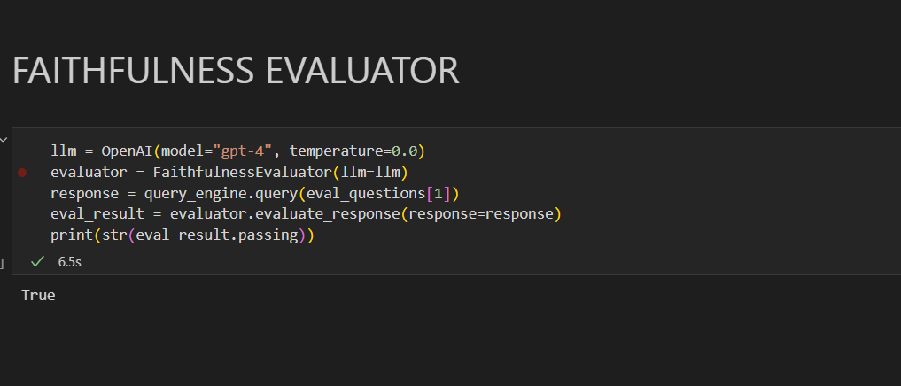
EVALUATION (Contd….)
FAITHFULNESS EVALUATOR: used to measure if the response from the query engine matches any source node.

